Slide 1
The Modern Salesforce Development Workflow with Visual Studio Code
Why you should use Visual Studio Code for your current and next Salesforce project
John Aaron Nelson
Senior Front End Developer
john.nelson@codescience.com
@JohnAaronNelson

Slide 2
Safe Harbor
Safe harbor statement under the Private Securities Litigation Reform Act of 1995:
This presentation may contain forward-looking statements that involve risks, uncertainties, and assumptions. If any such uncertainties materialize or if any of the assumptions proves incorrect, the results of salesforce.com, inc. could differ materially from the results expressed or implied by the forward-looking statements we make. All statements other than statements of historical fact could be deemed forward-looking, including any projections of product or service availability, subscriber growth, earnings, revenues, or other financial items and any statements regarding strategies or plans of management for future operations, statements of belief, any statements concerning new, planned, or upgraded services or technology developments and customer contracts or use of our services.
The risks and uncertainties referred to above include – but are not limited to – risks associated with developing and delivering new functionality for our service, new products and services, our new business model, our past operating losses, possible fluctuations in our operating results and rate of growth, interruptions or delays in our Web hosting, breach of our security measures, the outcome of any litigation, risks associated with completed and any possible mergers and acquisitions, the immature market in which we operate, our relatively limited operating history, our ability to expand, retain, and motivate our employees and manage our growth, new releases of our service and successful customer deployment, our limited history reselling non-salesforce.com products, and utilization and selling to larger enterprise customers. Further information on potential factors that could affect the financial results of salesforce.com, inc. is included in our annual report on Form 10-K for the most recent fiscal year and in our quarterly report on Form 10-Q for the most recent fiscal quarter. These documents and others containing important disclosures are available on the SEC Filings section of the Investor Information section of our Web site.
Any unreleased services or features referenced in this or other presentations, press releases or public statements are not currently available and may not be delivered on time or at all. Customers who purchase our services should make the purchase decisions based upon features that are currently available. Salesforce.com, inc. assumes no obligation and does not intend to update these forward-looking statements.

Slide 3
Welcome to The Modern Salesforce Development Workflow with Visual Studio Code
Salesforce 2015

Slide 4
John Nelson @JohnAaronNelson
Code Scientist

Slide 5
Dan Shahin @hijinx
Senior Developer Evangelist

Slide 6

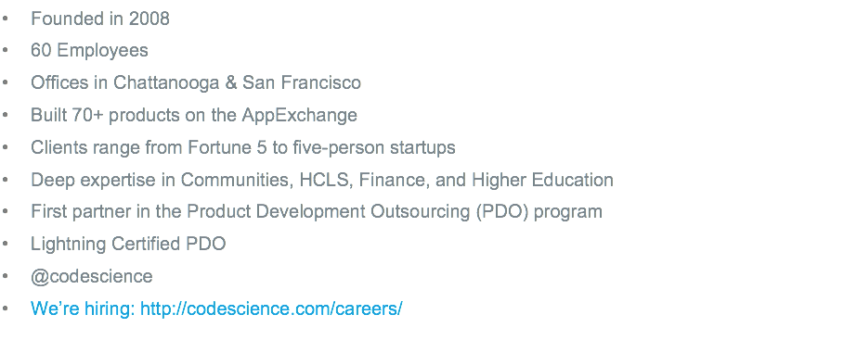

Slide 7
The Problem
Modern JavaScript development with Salesforce can be painful.
Notes:
So what’s the deal? Why are we here?
Douglas Crockford said “The people who should be the first to recognize the value of an innovation are often the last.”

Slide 8
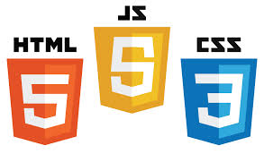



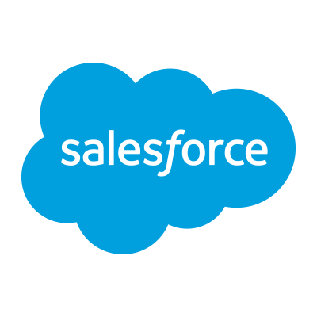


+
+
+
?
=
Notes:
(A brief skit to draw their attention)
S1: Hey S2, I have a problem
S2: Tell me about it, my wife keeps talking about babies.
S1: Keep your personal problems at home S1. I’m talking about all this talk about JavaScript development. With all the new frameworks and libraries coming out all the time, I don’t know what to use. I feel like my head is spinning.
S2: Yeah, and what’s the deal with everyone using a different operating system? The guy to my left uses Linux. The guy to my right uses Windows. And the guy across from me is a Mac fanboy. No one seems to be using the same tools.
S1: Web development used to be so simple. With all these new technologies coming out, I don’t know what to use.
S2: Everyone's talking about Angular and Angular 2.
S1: Yeah, I heard it’s built with something called TypeScript.
S2: Oh yeah, TypeScript and Angular 2. It’s big news. Who would’ve thought that two long time rivals like Google and Microsoft could come together in a spirit of mutual respect and collaboration? ;)
S1: So, S2, You work with a bunch of smart Salesforce developers. Is there anything you guys are doing modernize your development workflow?
S2: The other day I head this weird guy talking about something called Visual Studio Code. You heard anything about that?
S1: Yeah, here’s what I know…

Slide 9
Visual Studio Code
Introduced by Microsoft on April 30th at their //Build conference
Current Version: 0.7.0 (beta)

Slide 10
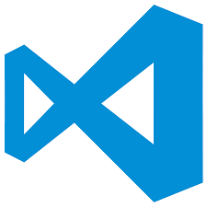
Visual Studio Code
Offers a new choice of tool that combines the simplicity of a code editor with what we need as developers using a modern workflow

Slide 11





Open Source Stack
Monaco*
OmniSharp
Roslyn
Notes:
Visual Studio Code stands on the shoulders of giants.
It’s built on Electron, the same foundation as Github’s new Atom editor
It’s built with open source. And because pretty much everything VSCode is built with is open source, and made with web technologies, the editor is hackable to the core. The editor is so meta, you can edit the editor with the editor.

Slide 12
Editor vs IDE
Notes:
So is Visual Studio Code a Text Editor, like Sublime Text, or Notepad? Or is it an IDE like Visual Studio Professional or Eclipse?

Slide 13


lightweight / fast
lots of menus and buttons
file / folder
project files
many languages
code understanding w/ Intellisense
many workflows
integrated build
keyboard centric
“file > new” / wizards
designers
lightweight / fast
debug
file / folder
with project context
platform tools
many languages
keyboard centric
task running & play to debug
Git integration
code understanding w/ Intellisense
Notes:
0) Lets examine some of the features of an editor vs an IDE to give Visual Studio Code some better context.
Starting off, a Text editor is supposed to be lighweight and fast. Apps such as Notepad or Sublime Text are relatively small applications that open fast and attempt to get out of your way as much as possible. On the other hand, an IDE, like Eclipse or Visual Studio Professional, has a lot of menus, buttons, and features.
An editor has no idea of project structure and the only organization is done with folders. An IDE has project and solution files.
An editor can work with any language that is text, but provides nothing else. An IDE inspects every bit of your code and provides intelligent code completion, refactoring suggestions, and method signatures.
An IDE has an integrated build system, where you can do things like press F5 or click a “Play” button to start a project
An IDE has “File > New” wizards, code design surfaces, and code generation.
It also has the ability to debug and provides platform specific tooling
And this is about where Visual Studio Code fits on the continuum.
It’s small, coming in under 70mb on a Mac. It’s fast: typically launching in less than 3 seconds to a blinking cursor. And it has a keyboard centric design with an extensive list of customizable shortcuts.
But it also has some features that typically belong to an IDE. It has a project settings folder for project level customizations, but the editor favors convention over configuration, so project files are not required. It has syntax highlighting 35+ languages and growing. It has a built in Task runner. It has incredible Git support baked in. It has a launch.json file which controls a Node.js debugger that can be started with a Play button! This editor has a really great Node.js debugger. But the biggest win, in my opinion, is VSCode has Intellisense for JavaScript! It’s a feature that really sets this editor apart from any other, real Javascript Intellisense, supported with TypeScript definition files that are as easy to install as right-clicking on a supported library in your code.

Slide 14
Salesforce and VSCode
Getting Visual Studio Code to recognize Salesforce files
Notes:
So how

Slide 15
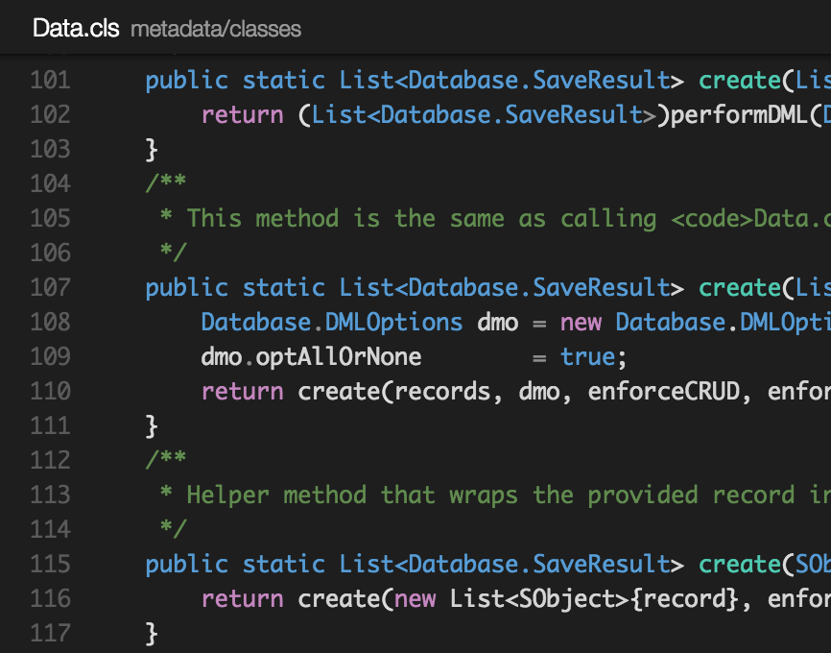
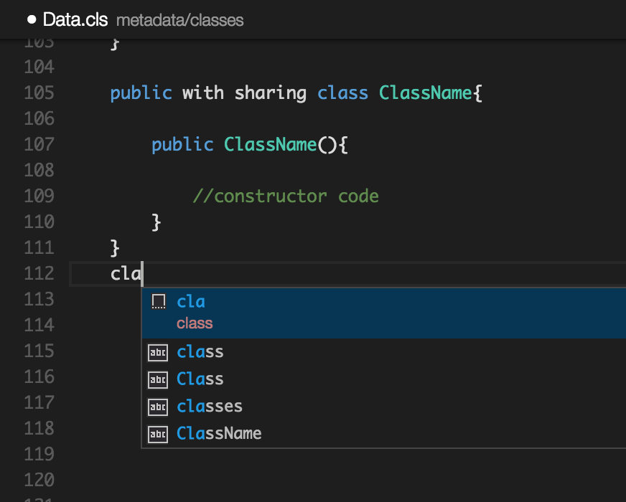
Using Visual Studio Code with Salesforce
Apex and Visualforce Syntaxes and Snippets
Snippets image goes here
Notes:
I mentioned earlier that VSCode has great language support for 35+ languages.
Well you can add Apex and Visualforce to the list.
With the magic of Open Source, we can import the appropriate Syntaxes and Snippets for Salesforce language support in Visual Studio Code.
Wow! So we can edit any Salesforce file in VSCode, with Colored Syntax highlighting, bracket matching, and indentation.
That’s cool. But what about that workflow we were supposed to be talking about?

Slide 16
The Modern Workflow
Working with Salesforce files in Visual Studio Code

Slide 17










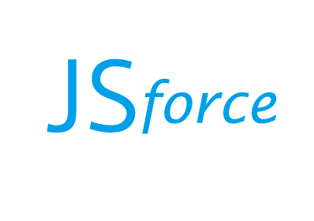
Versioning
Code
Tasks
Retrieve
heroku/force
Generate
Install
Build
Deploy
Notes:
0) Great! So we can edit Salesforce files in Visual Studio Code. But, how do we get from a blank page to an app, and get that app
Up to Salesforce?
First, we need to start off with a good foundation. There’s a lot of boilerplate that goes into a project that can be automated.
We can then import some open source packages into our app with a package manager like NPM or Bower to properly utilize open source libraries like jQuery or Angular.
Now we can Code.
another great feature of Visual Studio Code is it’s ability to run Tasks
Specifically, use the tasks.json file which we use to wrap a Gulp File.
VS Code also supports Gulp, Jake, and Grunt task runner files, natively, without using the tasks.json file, but tasks.json has special variables, like the current filename and path, and has “problem watcher” support so we can capture any errors from our build tools and get them right in the Editor window, with line highlighting and all! Great! So we can run tasks. What are we going to do with those tasks?
Well whenever we start a new JavaScript app for someone, there are tools that give us a great starting point, with a project structure, settings files, and packages that follow best practices for your organization. Why type all that code again or make copypasta when there are tools that can do it for you in mere seconds. So to make a new SPA, we can run a task such as “Create SPA” And when we need a new Salesforce file, we can run a command such as “Create Apex Class”
The only part of this workflow that can’t be enhanced with VSCode is when we start a new component and realize we need to import a new library. Installing packages is easiest from the command line. So just press Shift+Cmd+C and a terminal window will appear with your current working directory.
The build process is somewhat unique to each project, but Gulp and Webpack help us here. We can run build commands to lint, bundle, minify, and uglify our code. If we have a special command that launches a local server we can even use the launch.json file, which allows us to use the Play button and enables debugging for any Node.js application. We may also have “watch” tasks which watch our code for any changes and automatically runs. We can use watch tasks to auto-deploy our code
To deploy our code we can use the Salesforce supported Heroku Force CLI, or an open source tool such as JsForce.

Slide 18
Tying it all together with Tasks.json

Slide 19
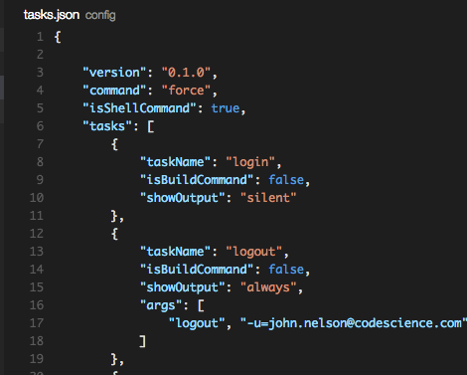
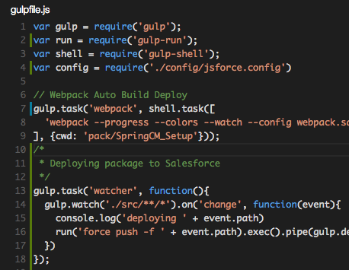
Tasks

Slide 20
The future for Visual Studio Code

Slide 21
The future is bright
Plugin support in Visual Studio Code is coming soon and will allow us to implement Intellisense for Apex and VF
The team continues to deliver regular iterations every month with a clear path forward shown by UserVoice.
The Visual Studio Code UserVoice site provides the path forward for Visual Studio Code.
VSCode is a crowd-sourced, free and open application, wholly funded and supported by Microsoft.
VSCode demonstrates the new Microsoft and their commitment to empowering developers on every platform.

Slide 22
Presentation Resources

Slide 23
Projects used to make a complete application
Show diagram of VSCode-DF15 at top,
then Saleforce-VSCode under that and to the side.
Then Gulp-Force under that, which wraps Force to provide, create Apex
The other side has Slush-Angular-Webpack for creating SPAs
Salesforce-VSCode has a tasks.json file which refers to Gulp-Force, the tasks.json file uses a problem-matcher on the task to get back any errors from the Force Push
Gulp-Force needs to be modified to accept a src file, then copy it to metadata, then run force push

Slide 24



Slide 25
Modern Workflow Talk Outline
Welcome to The Modern Salesforce Development Workflow with Visual Studio Code
The Problem: cross platform development is hard
What is Visual Studio Code
Open Source: Electron (Atom Shell) serves as the foundation with the Roslyn Code Editor (Open Source) resting on top
Modern App: Fast, Lightweight, Cross-Platform, Built with JavaScript, and Hackable to the core (edit the editor with the editor)
Nice Features: Fantastic Git integration, Node.js debugging, Keyboard centric workflow, and Tasks
What is the Modern Workflow we are discussing
JavaScript SPAs built with Angular and Typescript, and NPM
Salesforce files built using VRO, Remote Actions w/ Apex Patterns, REST API, and connected Node.js Apps (Heroku)
How can we use VSCode in the Modern Salesforce workflow
Grammars and Snippets (Firstmate/Textmate grammars thanks to Joe Ferraro)
Tasks with Tasks.json controlling and passing variables to Gulp & Force CLI, Ant, or anything
Auto-Deploy SF files with Gulp watch task
Auto-Deploy SPA files with Webpack watch task
Future extensibility with Omnisharp with the goal of implementing Intellisense for Apex and VF

Slide 26
Brief
The Talk
Me
John Nelson is a developer at CodeScience.

